Slide 1
Training zone
심하은

Slide 2
목차
개요
개발환경
학습 환경 설정
사용 모델 – PPO
학습 알고리즘
학습 결과
Reference & Source code

Slide 3
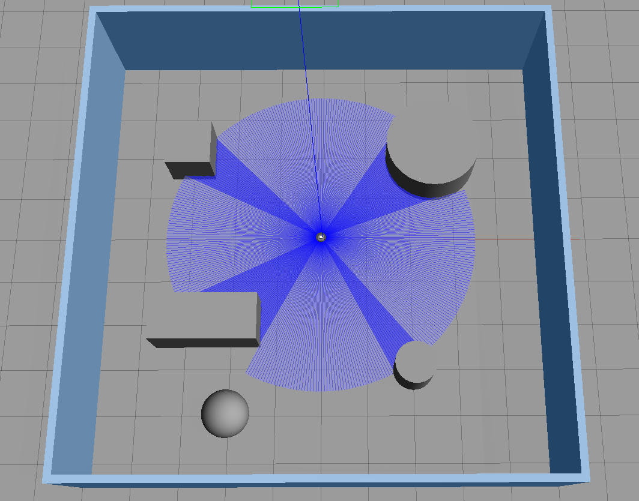
개요
Training zone 안의 장애물을 피해 목표 Object에 도달

Slide 4




개발환경

Slide 5
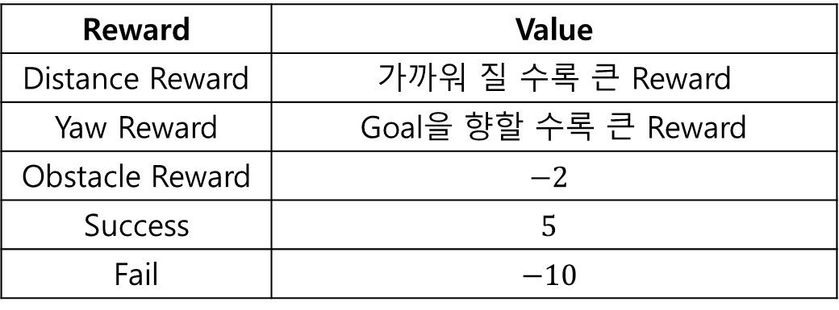
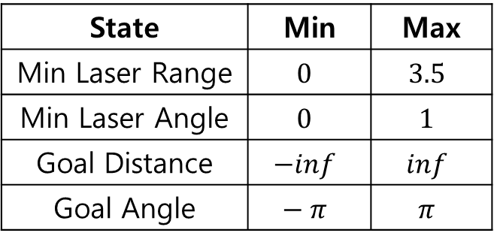
학습 환경 설정
Action
State
No | Action
0 | Left
1 | Forward
2 | Right
State | Min | Max
Min Laser Range | $$0$$ | $$3.5$$
Min Laser Angle | $$0$$ | $$1$$
Goal Distance | $$−inf$$ | $$inf$$
Goal Angle | $$− π$$ | $$π$$
Reward
Reward | Value
Distance Reward | 가까워 질 수록 큰 Reward
Yaw Reward | Goal을 향할 수록 큰 Reward
Obstacle Reward | $$−2$$
Success | $$5$$
Fail | $$−10$$

Slide 6
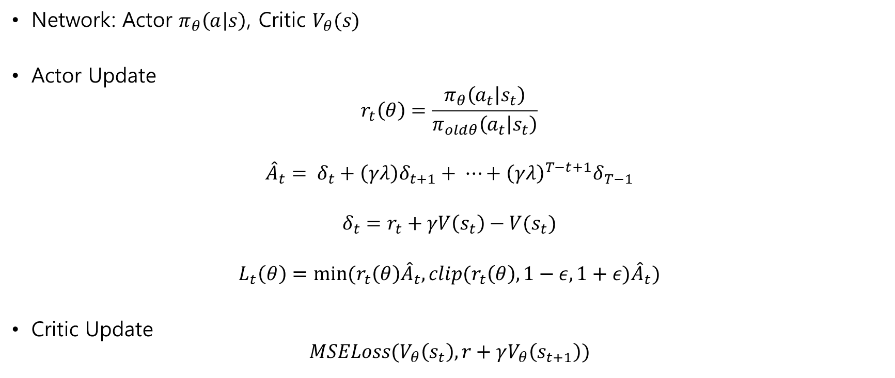
사용 모델 - PPO
Network: Actor $π_{θ}\left(a | s\right)$, Critic $V_{θ}(s)$
Actor Update
$$r_{t}\left(θ\right)=\frac{π_{θ}\left(a_{t} | s_{t}\right)}{π_{oldθ}\left(a_{t} | s_{t}\right)}$$
$${\hat{A}}_{t}= δ_{t}+\left(γλ\right)δ_{t+1}+ ⋯+{\left(γλ\right)}^{T−t+1}δ_{T−1}$$
$$δ_{t}=r_{t}+γV\left(s_{t}\right)−V(s_{t})$$
$$L_{t}\left(θ\right)=min⁡(r_{t}\left(θ\right){\hat{A}}_{t}, clip(r_{t}\left(θ\right), 1−ε, 1+ε){\hat{A}}_{t})$$
Critic Update
$$MSELoss(V_{θ}\left(s_{t}\right), r+γV_{θ}\left(s_{t+1}\right))$$

Slide 7
학습 알고리즘
for i in range(epoch):
while not Done:
for j in range(20):
Action 수행
(State, Action, Action Probability, Reward, Next State, Done) 저장
if Done:
break
Model update

Slide 8
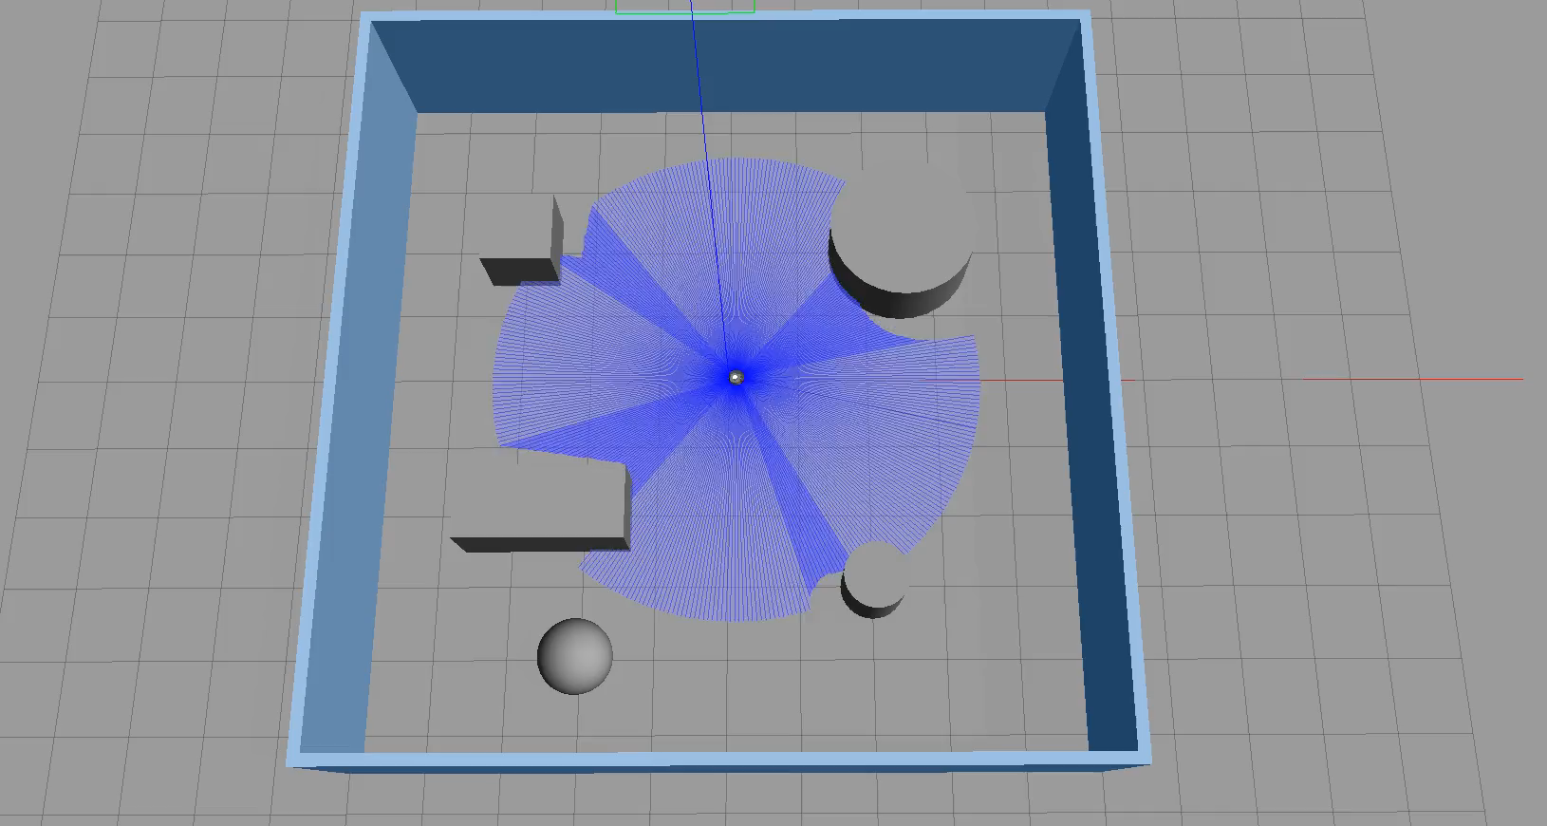
학습 결과

Slide 9
Reference
[PPO] https://arxiv.org/pdf/1707.06347.pdf
[turtlebot3]
https://github.com/ROBOTIS-GIT/turtlebot3_simulations/tree/master
Source code
[Github] https://github.com/5121eun/training_zone

